Slide 1
Concepts in Quasi-Experimentation
EPID 790
Fall 2021

Slide 2

Show of Hands, Sheffield, UK: © 2010pete

Slide 3
Are all randomized trials experiments?
Can we randomize all interventions?
Are all interventions experiments?
YES
NO
NO

Slide 4
How do we evaluate interventions that cannot (or should not - ethics) be randomized or evaluated using experiments?
Conduct studies that seem like (quasi) experiments
Quasi experimental studies are used to evaluate the effects of interventions or events that have already occurred.
State/ Federal legislation 🡪 health or economic outcomes
COVID-19 pandemic 🡪 mental health outcomes
Hospital policies 🡪 re-hospitalizations, cost reductions
Natural disasters 🡪 economy, mental health, suicides
Deforestation 🡪 incidence of flash floods
Recession 🡪 crime, mental health, other health outcomes
Mass shootings 🡪 firearm sales
Vaccination campaign 🡪 # vaccinated, incidence of infections

Slide 5
Some commonly used quasi-experimental methods
Pre-post comparison of means
Post comparison of means with a control group
Pre-post comparison of means with a control group (difference in differences or DiD)
BUT THESE METHODS MAY NOT ALWAYS BE IDEAL

Slide 6
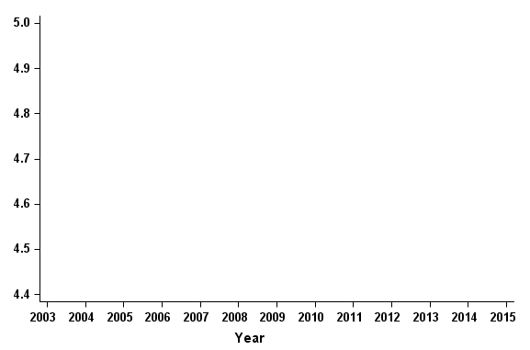
Association of Iowa prescription monitoring program with opioid pain reliever prescribing
Mean
Mean
Prescription rate
– IA (PMP)
Pre-post comparison of means

Slide 7
Association of Iowa prescription monitoring program with OPR prescribing
Mean
Prescription rate
– IA (PMP)
– IA (PMP)
– MO (no PMP)
Post comparison of means with a control group

Slide 8
Association of Iowa prescription monitoring program with OPR prescribing
Mean
Mean
Prescription rate
– IA (PMP)
– MO (no PMP)
Pre-post comparison of means with a control group; also known as difference in differences

Slide 9
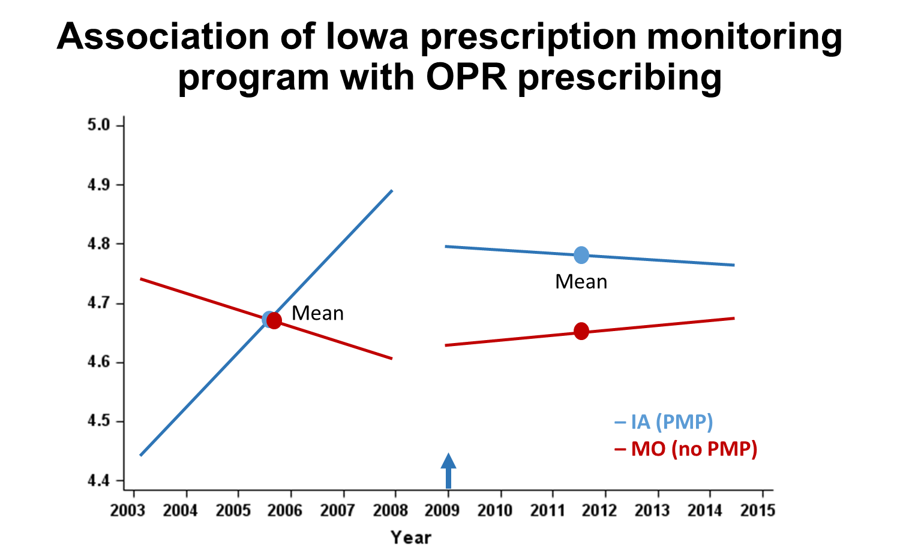
Why difference-in-differences (DiD) failed?
Prescription rate
DiD assumes parallel trends in the pre-policy period, but the assumption generally does not hold, especially while conducting policy analyses, where the outcome of interested exhibits by changing time trends.
Panel studies are same as DiD.

Slide 10
So what is DiD good for?
DiD is best when we can follow the same people in their pre-post analyses and compare an individual level outcome.
Examples:
Education performance before and after an educational intervention between an intervention and a control group
Self-harm behaviors before and after mental health treatment between an intervention and a control group
Crash rates on specific intervention and control road segments before and after reducing speed limits.

Slide 11
But what to do about policy analyses where the policy impacts entire cities, counties, states, country? And the outcomes follow time trends?

Slide 12
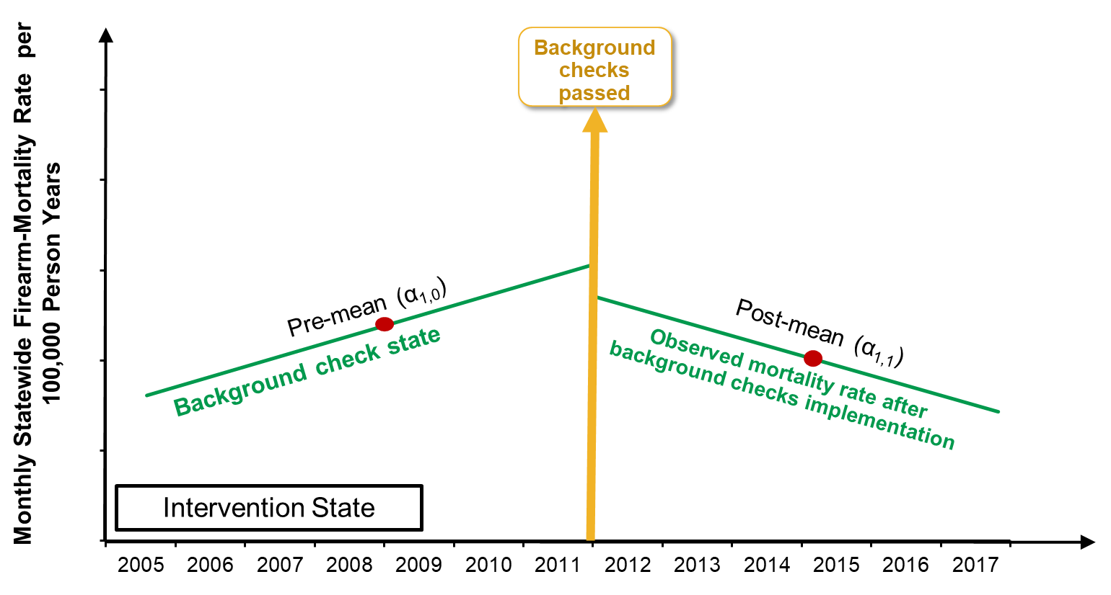
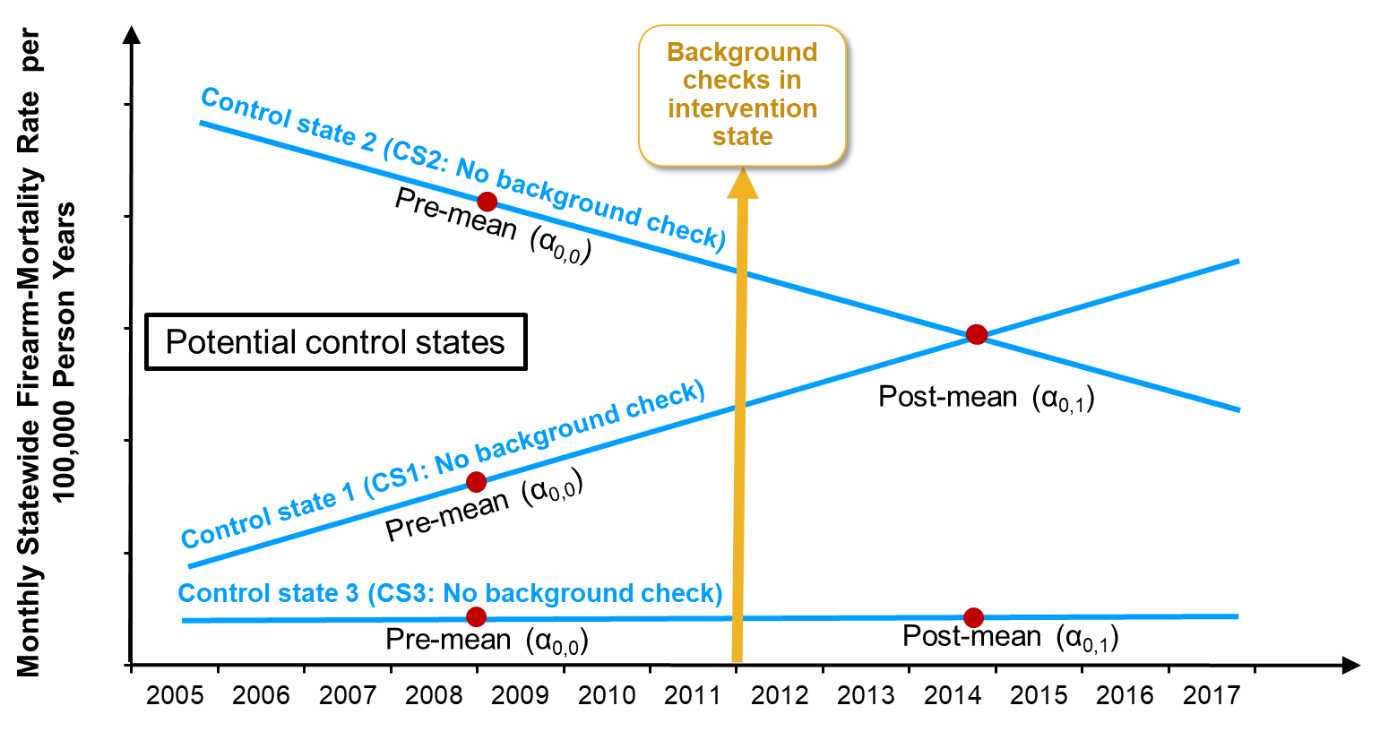
Can we do a straight up DiD if we use control state 1 only?
Maybe: 1) we wouldn’t explicitly understand what changed 2) DiD assumes post-intervention parallel trends (more on this on next slide)
Can we use control states 2 or 3 in a DiD analysis?
No (parallel trends violated)
Could/should we just ignore controls 2 and 3?
Substantive question
If we combine all three controls, what will the trends look like?
Trends will be affected most by the largest state in the sample
Then What?

Slide 13
Synthetic controls as a quasi-experimental design
Background checks passed
Post-mean (α_{0,1})
Synthetic control (75% CS1 + 5% CS2 + 20% CS3)
But how to measure this change?
Pre-mean (α_{0,0})
Monthly Statewide Firearm-Mortality Rate per 100,000 Person Years
Pre-mean (α_{1,0})
Post-mean (α_{1,1})
Background check state
Observed mortality rate after background checks implementation
Development of a synthetic control state and its use in a DiD analysis
Calendar years
Also known as matched DiD
R-package – “Synth”: https://www.jstatsoft.org/article/view/v042i13

Slide 14
Interrupted time-series (ITS) as a quasi-experimental design
When something is measured repeatedly over time for a person or other entity, it is called a time series
The series is equally spaced (monthly, quarterly, yearly)
More commonly at ecologic level (e.g., city or state level - crime rates, # of infections) but can be at person-level
Future observations are correlated with and can be predicted by past observations
Auto-correlation, e.g., trends, seasonality, and local autocorrelation

Slide 15
Everyday example of using auto-correlation to predict a time series
What might you use to predict the temperature tomorrow?
What month is it? (Seasonality)
What temperature was it yesterday? (Local auto-correlation)
Is global warming slowly increasing the temperature (e.g., 0.00001 degree higher expected than last year)? (Trend)
Are there other variables from today that you can use too (e.g., barometric pressure)? (lagged covariates)

Slide 16
Interrupted time-series (ITS) as a quasi-experimental design
When something is measured repeatedly over time for a person or other entity, it is called a time series
The series is equally spaced (monthly, quarterly, yearly)
More commonly at ecologic level (e.g., city or state level - crime rates, # of infections) but can be at person-level
Future observations are correlated with and can be predicted by past observations
Auto-correlation, e.g., trends, seasonality, and local autocorrelation
A policy or event can be an interruption in that time-series, allowing us to examine the change in characteristics of the time-series before and after

Slide 17
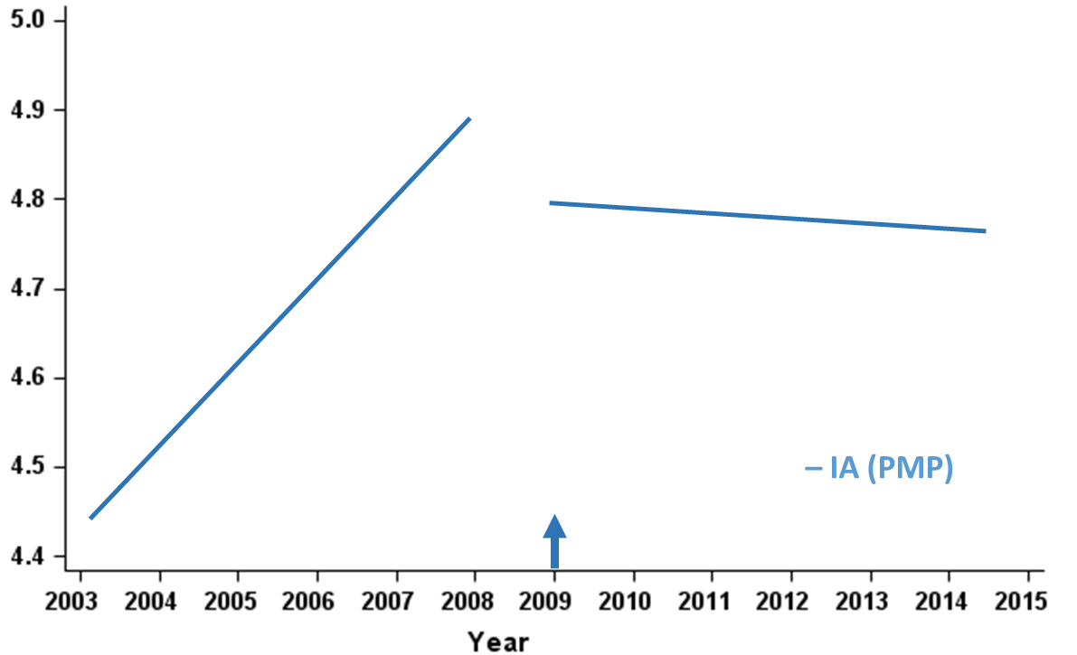
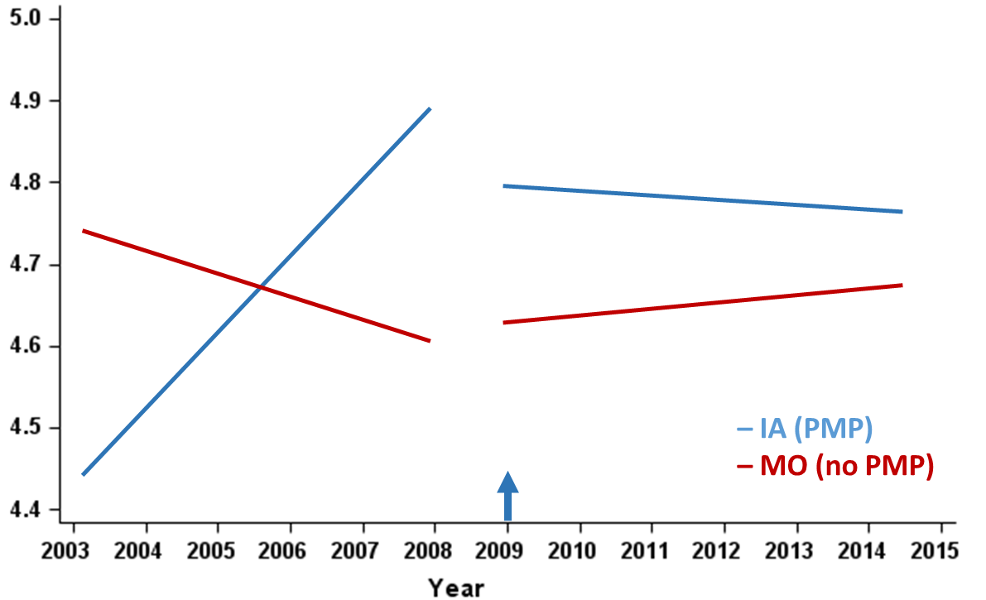
Two types of ITS designs
Single series ITS
ITS with a control group
Auto-Regressive Integrated Moving Average (ARIMA) models
Proc ARIMA (SAS)

Slide 18
Single series ITS
β₃
Post-PMP trend change
(post-slope – pre-slope)
β₁
+/-
+/-
Pre-PMP trend (time slope)
Absolute change in the outcome level
β₂
+/-
β₀
Outcome_{intervention(i)*t} = β₀ + β₁*time_{t} + β₂*level_{i} + β₃*trend_{i*t} + e

Slide 19
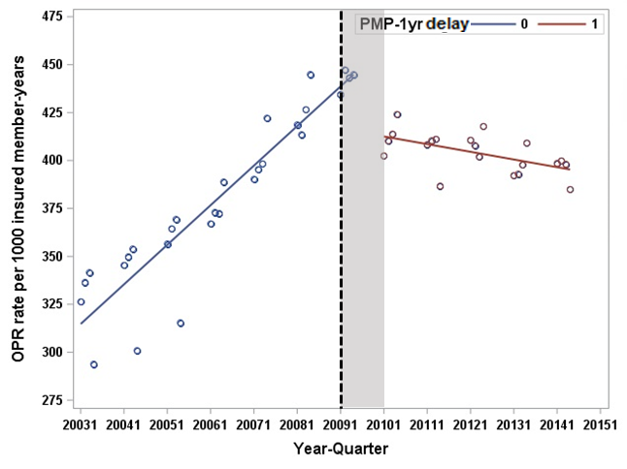
Association of Iowa prescription monitoring program with OPR prescribing (Ranapurwala, 2018, Pain Med)
Single series ITS
β₁
β₂
β₃
Outcome | Pre-trend | Absolute level change | Post-trend change
Overall OPR rate | 5.1 (4.4, 5.8) | -34 (-51, -17) | -6.0 (-7.3, -4.7)

Slide 20
Association of Iowa prescription monitoring program with OPR prescribing (Ranapurwala, 2018, Pain Med)
Single series ITS
Predicted rate in 2014_{(no int)}
= β₀ + β₁*time_{t (2014= time-44)}
= 315 + (5.1*44)
= 539.4
Actual rate in 2014_{(int)}
= β₀ + β₁*time_{t} + β₂*level_{i}
+ β₃*trend_{i*t (2014 = time-16)}
= 539.4 + (-34) + (-6.0*16)
= 409.4
Rate difference | Rate ratio
-120 | 0.76
β₁
β₂
β₃
Outcome | Pre-trend | Absolute level change | Post-trend change
Overall OPR rate | 5.1 (4.4, 5.8) | -34 (-51, -17) | -6.0 (-7.3, -4.7)

Slide 21
Controlled ITS
β_{3 (Pre-slope – post-slope)}
β₂
β₁
β_{7 (slope change difference)}
= intervention slope change – β3
β6 (level change difference) = interv level change – _{β2}
β₀
β₄
β_{5 (baseline trend difference)}
_{= interv baseline trend – β1}
– IA (PMP)
– MO (no PMP)
Outcomeintervention(i)*group(k)*time(t) =
β₀ + β₁*time_{t} + β₂*level_{i} + β₃*trend_{i*t} + β₄*group_{k}
+ β₅*time_{t}*group_{k} + β₆*level_{i}*group_{k} + β₇*trend_{i*t}*group_{k} + e

Slide 22
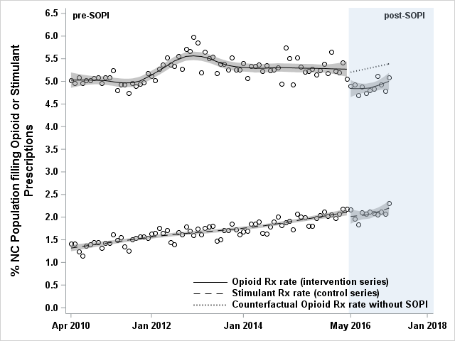
Controlled ITS
Association of NC Safe Opioid Prescribing Initiative (SOPI) with opioid prescribing in NC
(Ranapurwala, 2020, Am J Prev Med)
β_{6 = 0.53%}

Slide 23

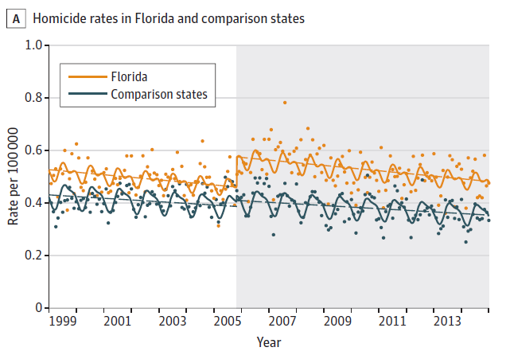
Controlled ITS
Humphreys et al., JAMA Internal Med, 2017

Slide 24
Controlled ITS
Predicted rate (at time t, if intervention group followed control trends)
= β₀ + β₁*time_{t} + β₂*level_{i} + β₃*trend_{i*t} + β₄*group_{k} + β₅*time_{t}*group_{k}
Where t= end of study time which will be the same for β₁ & β₅ and different for β₃; k=intervention group; i=intervention
Actual rate (intervention group at time t under observed trends)
= β₀ + β₁*time_{t} + β₂*level_{i} + β₃*trend_{i*t} + β₄*group_{k} + β₅*time_{t}*group_{k} + β₆*level_{i}*group_{k} + β₇*trend_{i*t}*group_{k}
Where t= end of study time which will be the same for β₁ & β₅ and different for β_{3 and} β₇; k=intervention group; i=intervention

Slide 25
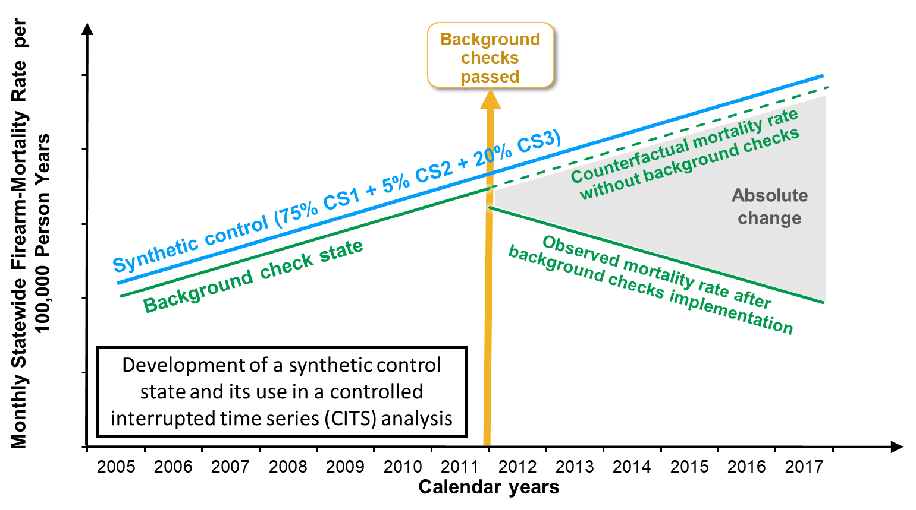
What is better than CITS and Synthetic control?
Controlled ITS + Synthetic control

Slide 26
In summary
Don’t use for policy analysis
Pre-post comparison of means
Post comparison of means with a control group
Pre-post comparison of means with a control group (DiD)
Best for policy analysis
Synthetic controls (Matched DiD)
ITS/ CITS
CITS + Synthetic controls

